Slide 1
LOVE THE LORD WITH ALL YOU’VE GOT
Love the Lord with all your heart,
all your soul, all your mind.
Love the Lord with all your strength.
Love the Lord with all your heart,
all your soul, and all your mind.
Love the Lord with all you’ve got.

Slide 2
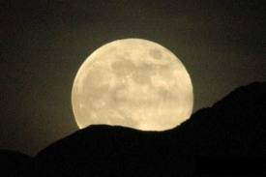
Love the Lord in the morning,
love the Lord at night,
Love the Lord in the middle of the day
and in the evening moonlight.
Love the Lord with everything you’ve got.
Love the Lord with everything.

Slide 3
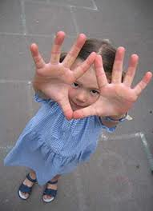
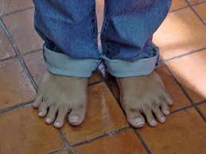
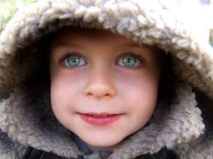
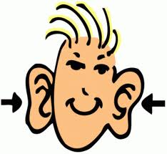
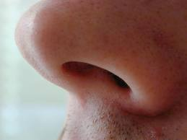
Love him with your fingers,
love him with your toes,
Love him with your eyes and ears,
love him with your nose.
Love the Lord with everything you’ve got.
Love the Lord with everything.

Slide 4
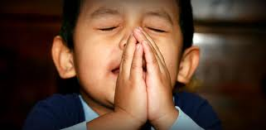
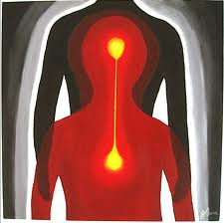
Love the Lord with all your heart,
all your soul, all your mind.
Love the Lord with all your strength.
Love the Lord with all your heart,
all your soul, and all your mind.
Love the Lord with all you’ve got.

Slide 5
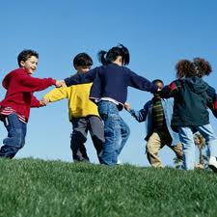
Love him with your talents,
love him with your time
Love him with your actions,
let him see you shine.
Love the Lord with everything you’ve got.
Love the Lord with everything.

Slide 6
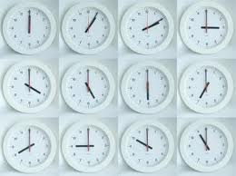
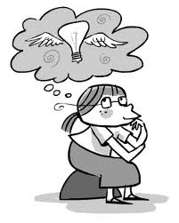
Love him with your body,
love him with your mind
Not just every now and then,
love him all the time.
Love the Lord with everything you’ve got.
Love the Lord with everything.

Slide 7
Love the Lord with all your heart,
all your soul, all your mind.
Love the Lord with all your strength.
Love the Lord with all your heart,
all your soul, and all your mind.
Love the Lord with all you’ve got.

Slide 8
Love the Lord with all your heart,
all your soul, all your mind.
Love the Lord with all your strength.
Love the Lord with all your heart,
all your soul, and all your mind.
Love the Lord with all you’ve got.

